Slide 1
BDA Mini Project
Movie Recommendation Engine
PB61 PB62 PB64 PB65
PA34

Slide 2
Introduction
In this Mini-project,we have created a movie recommendation engine based on the plots of the movies. We have used MongoDB as backend for storing the data and Python as frontend to perform preprocessing and Algorithms using pymongo.

Slide 3
Dataset
https://www.kaggle.com/tmdb/tmdb-movie-metadata
https://www.kaggle.com/rounakbanik/the-movies-dataset
The dataset includes columns like: movie name, language, budget. Revenue, their average ratings and how many people gave the review.
Dataset size: ~500 MB

Slide 4

CRUD Operations
Update Command
2.Delete Command

Slide 5
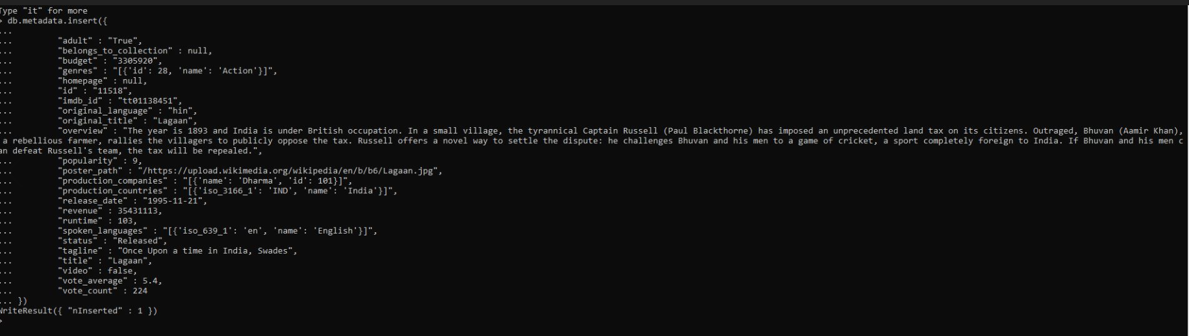
3.Insert command

Slide 6
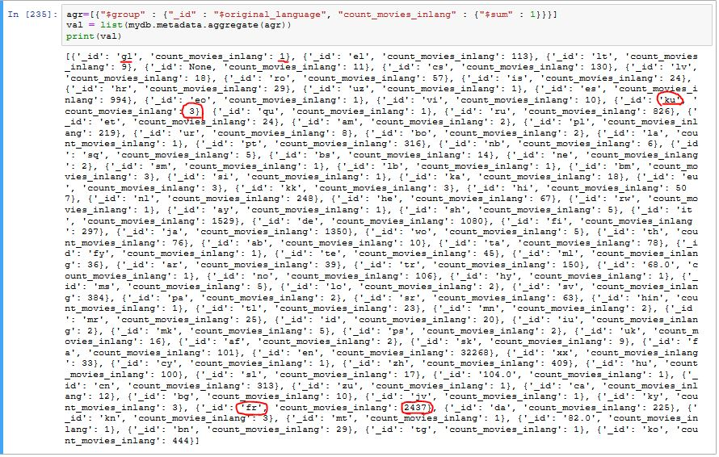
Queries using PyMongo
Aggregate framework- We used aggregate to group movies by their language and to print how many movies are present from each language

Slide 7
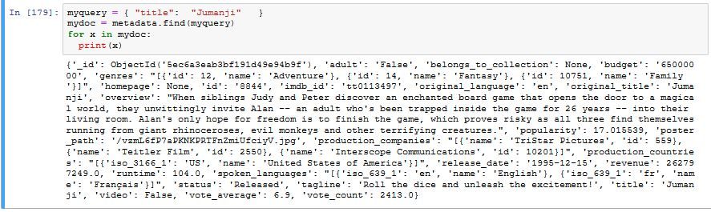
2. Find- This query finds all the documents matching the given condition.

Slide 8
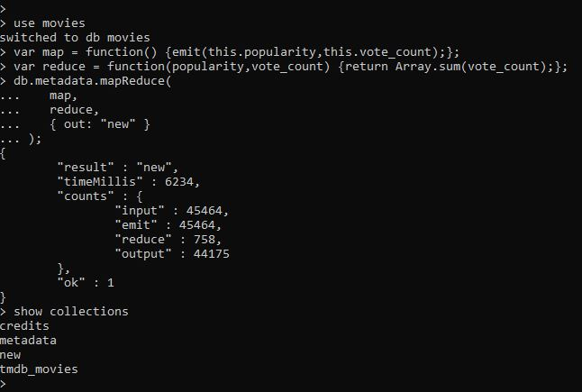
Mapreduce
Map: It is a JavaScript function, which is use to generate key-value pairs.
Reduce: A JavaScript function use for grouping all the documents which have the same key.

Slide 9
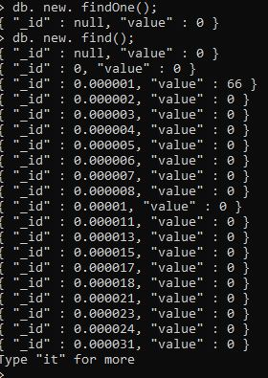
Here key-value pairs of popularity and vote_count is mapped and stored in a new collection named new.

Slide 10
Preprocessing
“Belongs to category” had too many NaN values so the column was dropped.
For clustering, we used the parameters: budget,popularity,revenue,runtime,vote_average,vote_count
So we made a new dataframe with these columns and normalize them using MinMaxScaler from sklearn

Slide 11
K-means clustering
We took the columns: Budget,popularity,revenue,runtime,vote_average,vote_count.
Then, we normalized the columns.
We fit the data into k-means clustering algorithm .
Then check the score for best number of clusters.

Slide 12
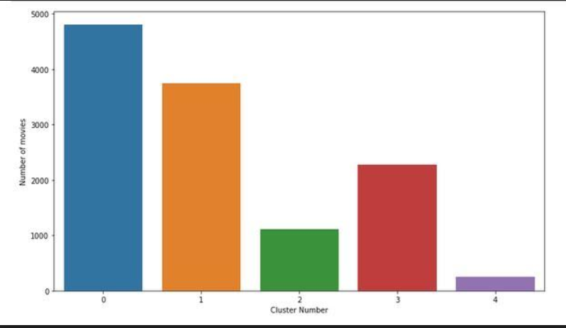
The five clusters with the number of movies in each clusters are as follows: If you like movies from a specific cluster then you are most likely to be recommended movies from the same cluster.

Slide 13
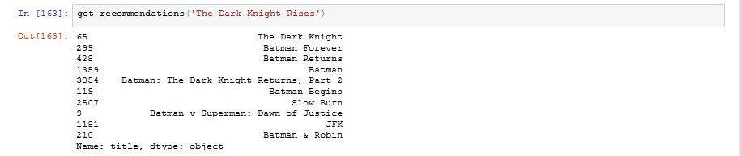
Plot based Movie recommender
We have built a recommender reliant on the following:
The actor
Related genres
Movie plot keywords

Slide 14
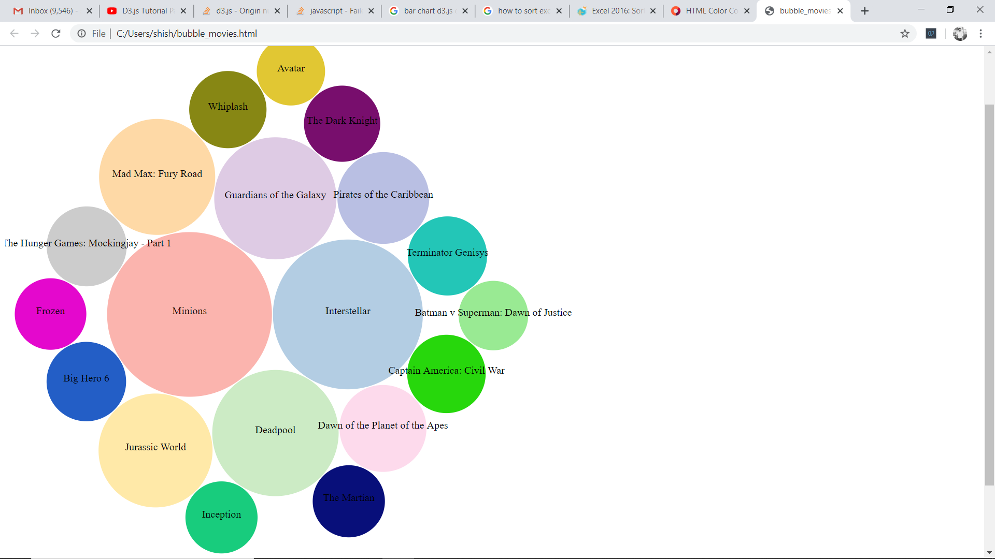
D3.Js Visualizations
Bubble Chart-
Following is the illustration of bubble chart showing the top twenty popular movies. The size of the bubble depends on the budgets of the films.

Slide 15
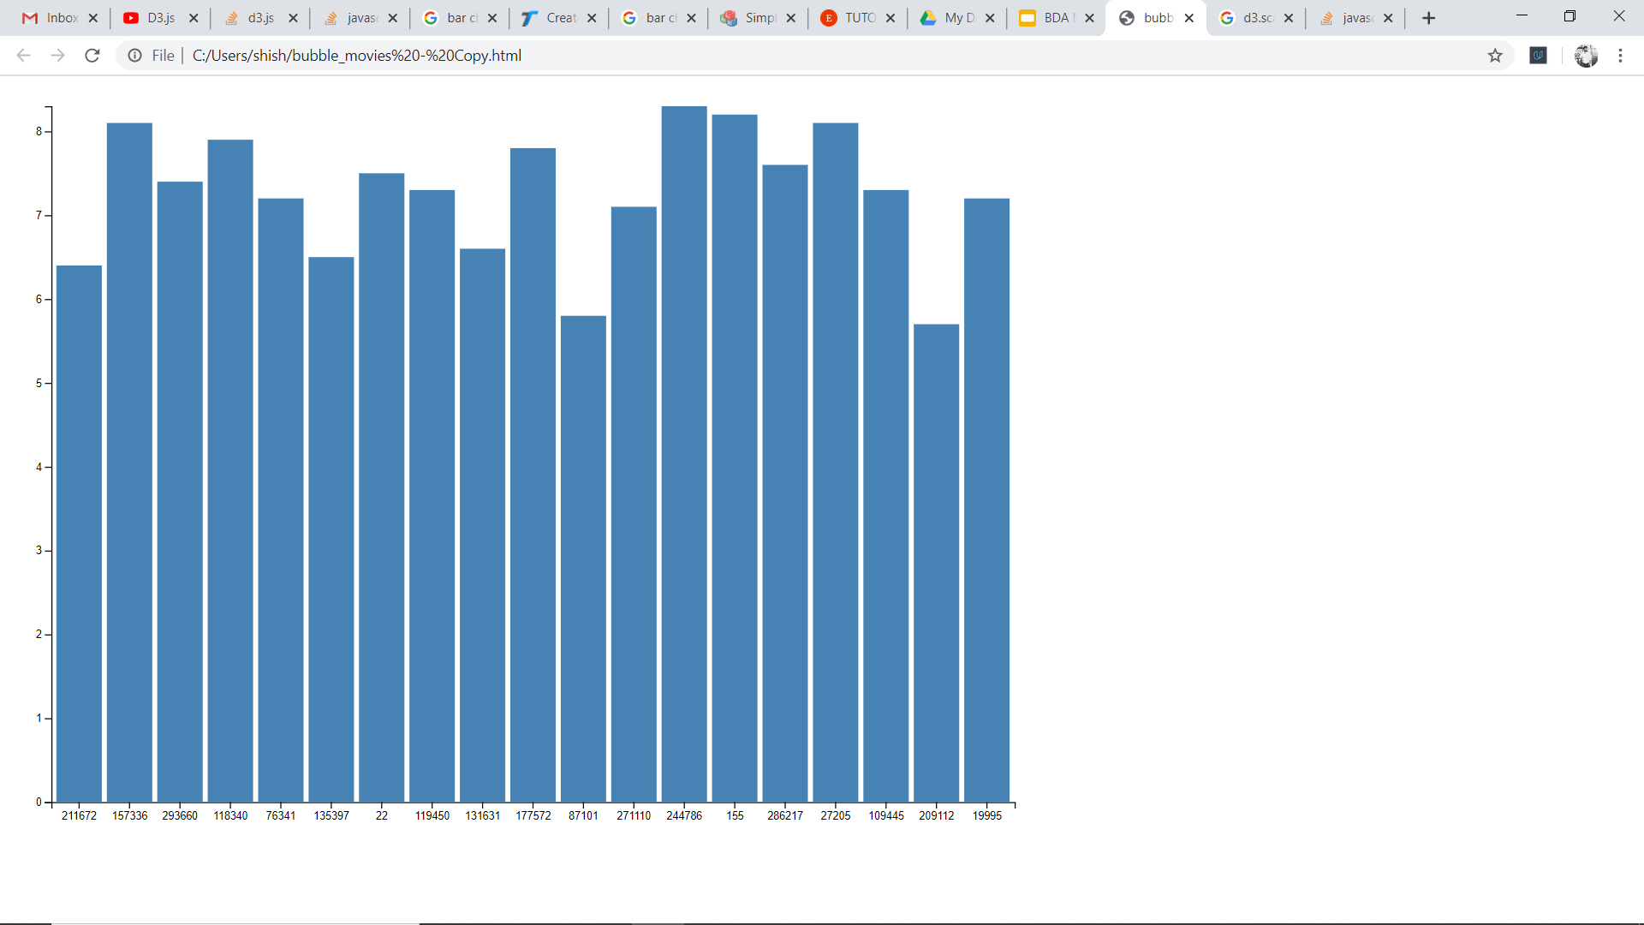
2. Bar Chart-
Here the movies are mapped on a bar chart to compare their average ratings from viewers.

Slide 16
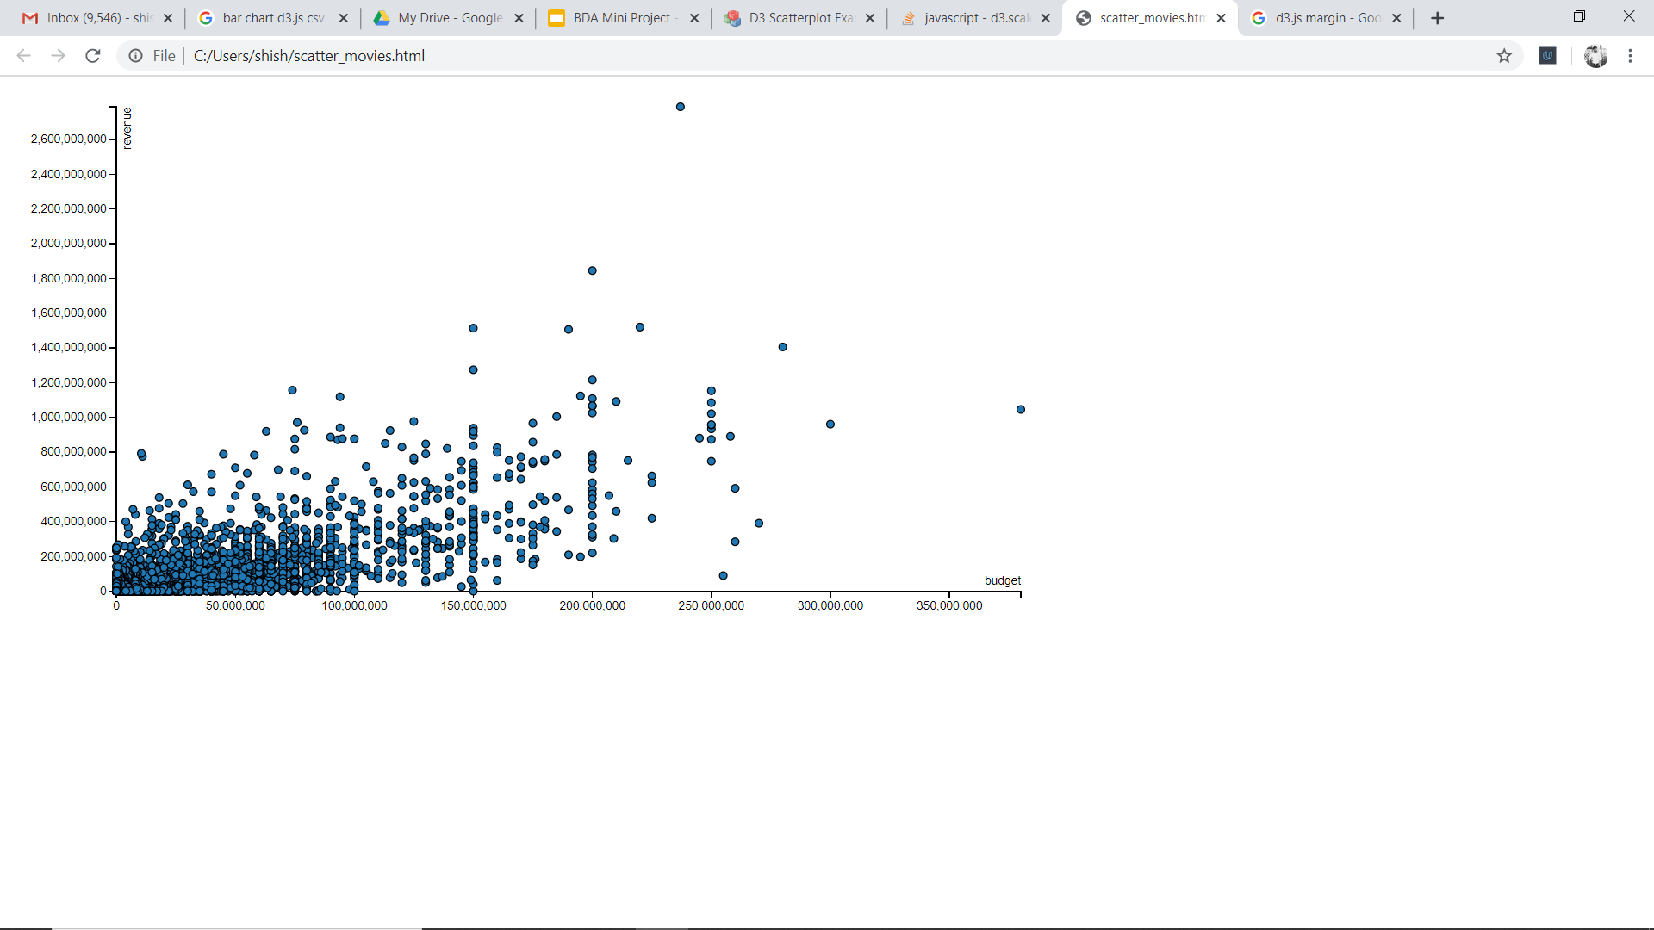
3. Scatter plot-
In this plot all the movies are mapped according to their budget and revenue.

Slide 17
Thank You

